Slide 1


Module 7 – Creating and Managing Glossary Terms and OKRs

Slide 2
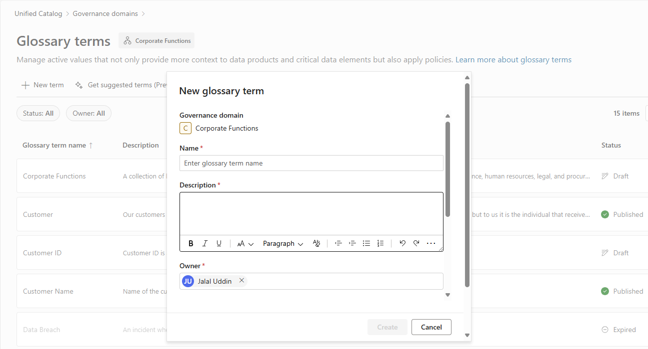
Glossary Term
Business context that defines how data assets should be managed, governed, and made discoverable
Capabilities
Create and manage terms to describe data
Add metadata, acronyms, and resources to terms
See related terms, synonyms, and data products
Use copilot experience to get suggested terms automatically
Manage policies at the term level and apply to data products
2
Notes:
Glossary enable you to model business vocabularies for your business. For example, Customer Lifetime Value (CLV) - The total revenue expected from a customer over the entire relationship.
You attach terms to a data product, any access policies defined at the glossary term level get automatically applied to the data product when they’re linked.
If you select ‘Permit data copies’ = you’re explicitly allowing consumers of the data product to copy, export, or duplicate the data (e.g., download to Excel, use in downstream reports
Glossary information contains more than just the description of the term. The relationships help consumers learn what other terms they need to understand and what data is relevant to the term they are learning about. You can define glossary term at the governance domain level. Manage policies that are automatically added when the glossary term is linked to a data product.

Slide 3
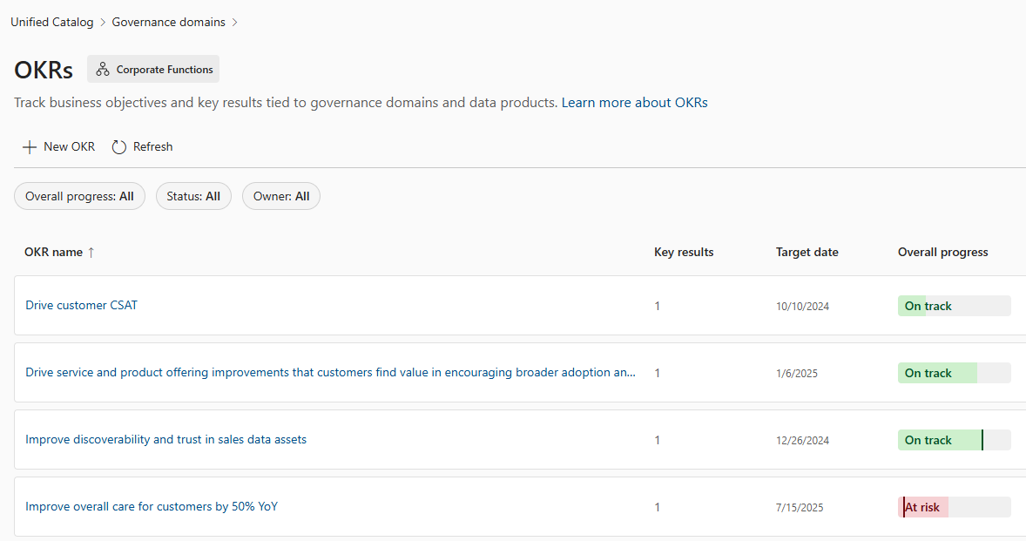
Objective and Key Results (OKRs)
Aligns operational data management with strategic business objectives
Capabilities
Create and manage objectives and key results for data
Set goals, progress, and status for each key result
Update and edit key results as needed
Link data products to show business value of OKRs
Track and monitor OKRs across data products
3
Notes:
In Microsoft Purview, OKRs (Objectives and Key Results) are trackable business objectives tied to governance domains and data products to emphasize the value of business data.
OKRs help bridge the gap between business objectives and the data estate, ensuring that data governance is aligned with business goals
An OKR consists of:
Objective: The goal or desired outcome of a governance domain, such as a 10% increase in sales or a 3% reduction in support cases1.
Key Results: Measurable, time-bound goals associated with the objective, used to track progress
Owners: Users responsible for maintaining the objective.
Definition: A high-level description of the objective
Target Date: The expected date to achieve the goal
OKRs in Microsoft Purview are designed to capture strategic objectives and measurable outcomes, allowing teams to prioritize their work and focus on achieving meaningful results

Slide 4

OKRs - Attributes
Who? Typically, business leaders with an understanding of how business functions and where it’s headed
Definition
Target date
Key Results
An overarching description of your objectives. Good objectives are specific and achievable in a time frame.
When you expect to achieve your goal.
These are measurable, time-bound metrics associated with your objective. A good metric is SMART.
Notes:
SMART = Specific, Measurable, Achievable, Realistic, and Timebound.
Typically Business leaders with an understanding of how the business functions and where it's headed

Slide 5
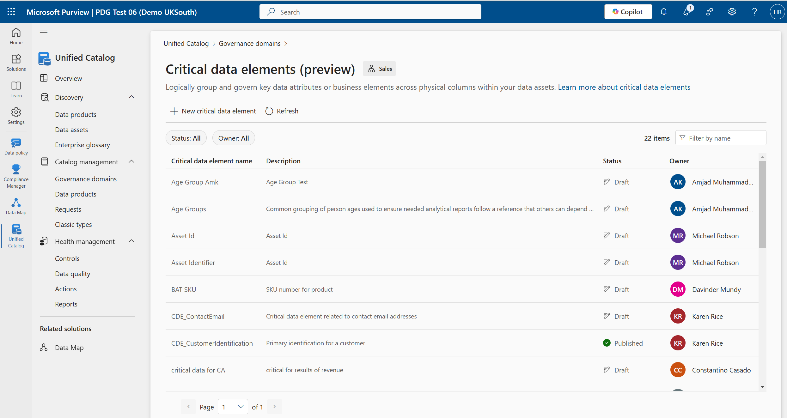
Critical Data Elements (CDE)
Logical groupings of significant information across your data estate
Capabilities
Create and manage logical concepts for data
Map columns from different data assets to CDEs
Define single source of truth for data
See data products that contain CDEs
Manage policies and data quality roles at the CDE level
5
Notes:
Critical data elements are a logical grouping of important pieces of information across your data estate. For example: A "Customer ID" critical data element can map "CustID" from one table and "CID" from another table into the same logical container. These groupings can make data easier to understand as well as promoting standardization. Data quality rules and access policies can be attached to these elements to further secure sensitive information across your data estate.

Slide 6
Module - 7
Lab time!

